Slide 1

Predicting Real Disaster Tweets using Natural Language Processing and Machine Learning Techniques
DS 688 Natural Processing Language
Rohith Sanku
Tharanth Gunnala
Sai Prahaladh K
Srinivas G

Slide 2

Introduction
Natural disasters such as earthquakes, floods, and hurricanes can cause significant damage and loss of life. Rapid dissemination of accurate information during such events is critical for effective emergency response and resource allocation. Social media platforms, particularly Twitter, have become vital channels for real-time information sharing during disasters.
However, the vast volume of tweets, including rumors and irrelevant information, makes it challenging to quickly identify actionable intelligence.
This presentation explores the application of Natural Language Processing (NLP) and Machine Learning (ML) techniques to filter and predict real disaster-related tweets, enhancing the ability of authorities and first responders to act swiftly and efficiently.

Slide 3

Problem Statement
The challenge is to develop a system that can efficiently and accurately distinguish between real disaster-related tweets and irrelevant content. Such a system must process vast amounts of unstructured text data, identify relevant patterns, and ensure high accuracy in predictions to be practically useful for disaster response teams. This project aims to leverage Natural Language Processing (NLP) and Machine Learning (ML) techniques to address this challenge, providing a reliable tool for emergency management and improving overall disaster response efficiency.

Slide 4
Objective
The primary objective of this project is to develop a robust system capable of accurately predicting real disaster tweets from the vast stream of social media data. By leveraging NLP and ML, we aim to:
Enhance Disaster Response: Provide a reliable tool for emergency services to quickly identify and prioritize genuine disaster-related information.
Improve Data Accuracy: Minimize the noise and misinformation in the dataset, ensuring that only relevant and factual tweets are highlighted.
Facilitate Resource Allocation: Enable more efficient deployment of resources and personnel by providing timely and accurate situational awareness.
Contribute to Research: Advance the field of disaster management by showcasing the potential of combining NLP and ML for real-time data analysis and decision-making.

Slide 5

Methodology
Exploration of key methodologies including tokenization, lemmatization, Word Embeddings and the use of advanced models machine learning models,

Slide 6
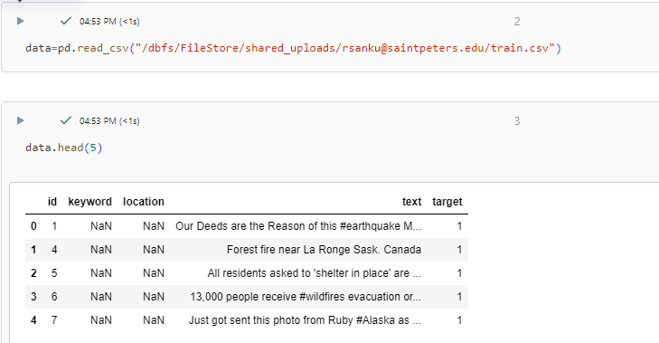
Dataset Description
Dataset Columns: Detailed explanation of the dataset used, including columns like ID, keyword, location, text, and target. Each column's role in model training and prediction accuracy is highlighted.
Significance: Emphasizing the importance of each column in the context of disaster prediction, helping in data preparation and feature engineering for better model performance.

Slide 7
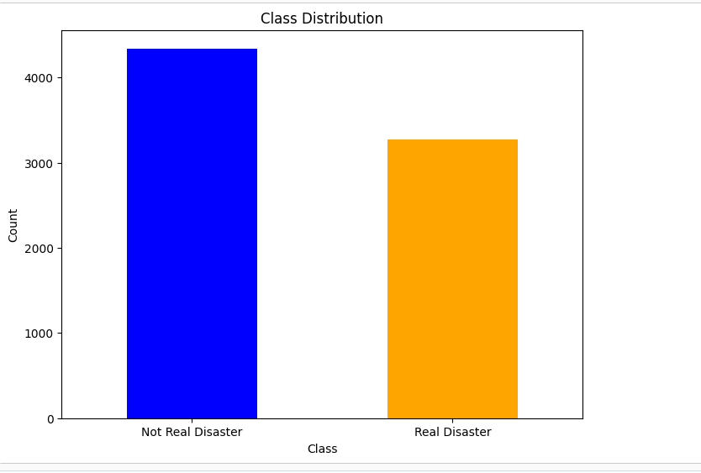
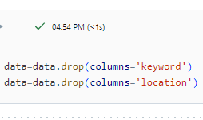

Slide 8
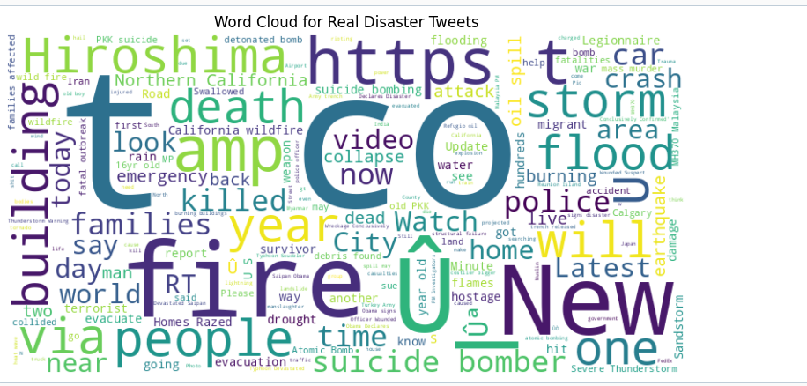

Slide 9
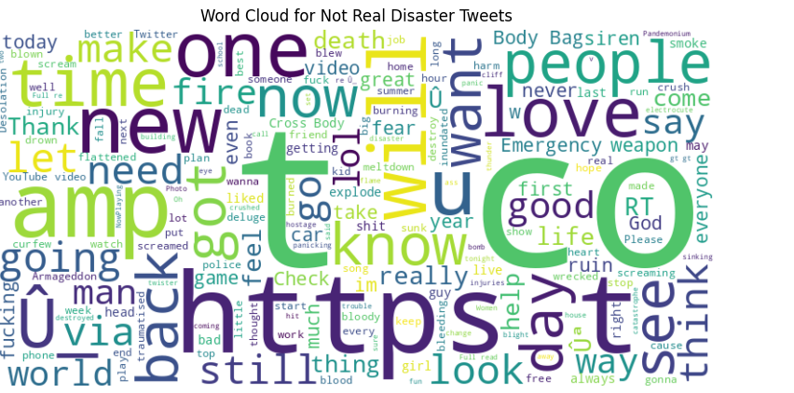
EDA

Slide 10
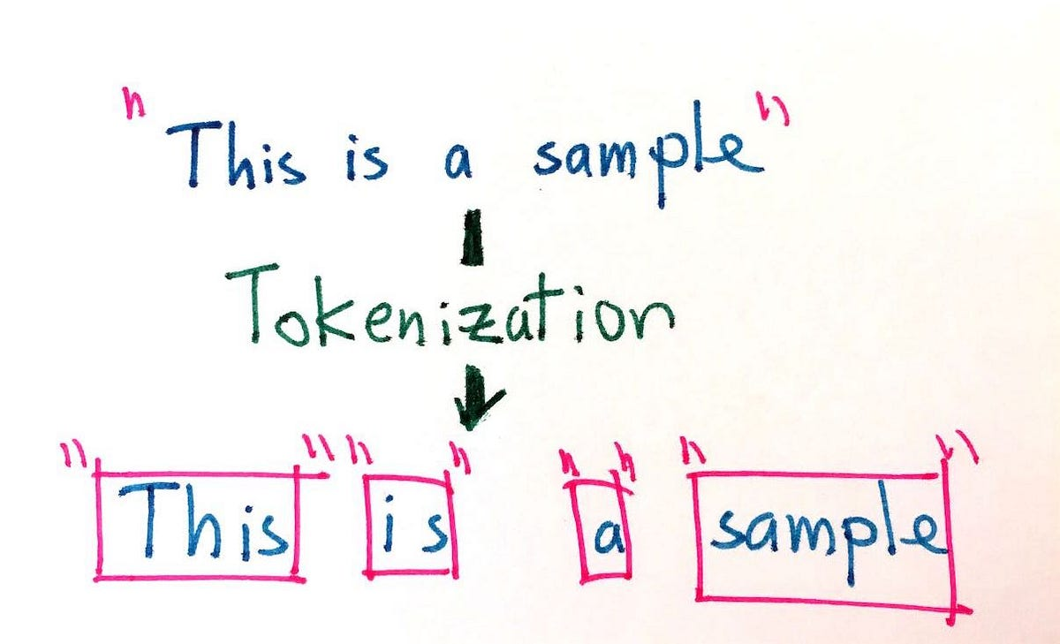
Data Preprocessing
Tokenization
Splitting Text: The text of each tweet is split into individual words or tokens. This is typically done by separating the text based on spaces and punctuation. For example, the tweet "Earthquake in California! Stay safe everyone." would be tokenized into ["Earthquake", "in", "California", "!", "Stay", "safe", "everyone", "."].
Handling Special Characters: Special characters, punctuation, and emojis are often removed or treated as separate tokens. This step ensures that only meaningful words are considered during analysis.
Normalization: This involves converting all tokens to lowercase to ensure uniformity. For example, "Earthquake" and "earthquake" would be treated as the same token.
Removing Stop Words: Commonly used words that do not contribute significant meaning to the text (e.g., "and", "the", "in") are removed. This step helps in focusing on the important words that carry substantial information about the disaster.

Slide 11
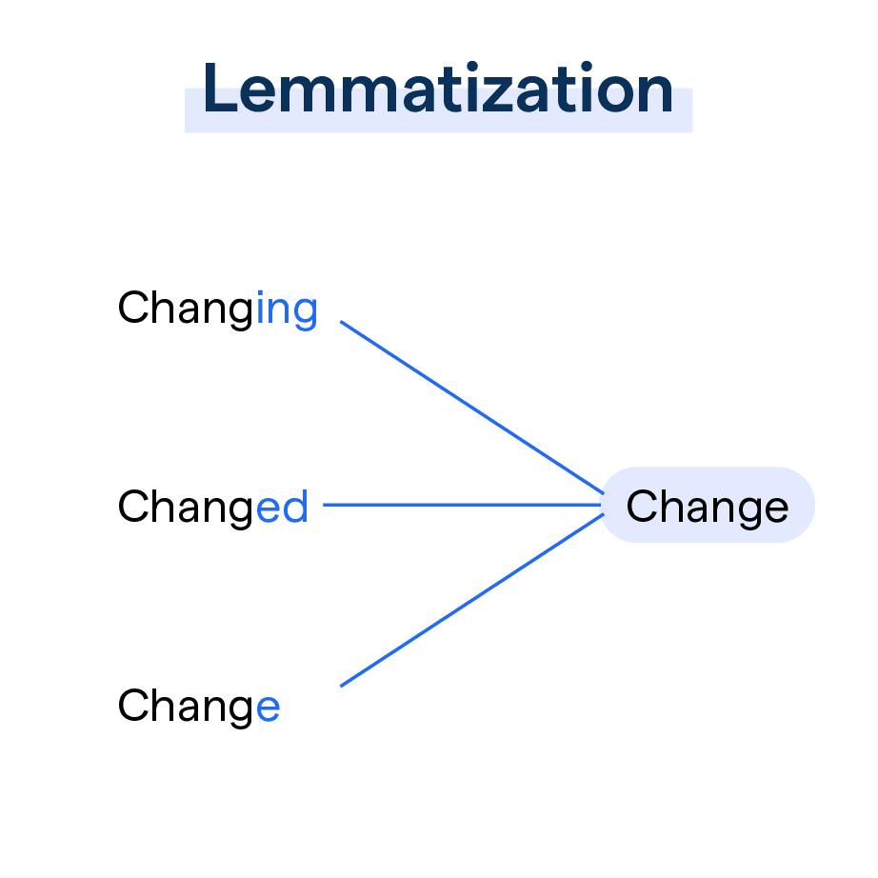
Data Preprocessing
Lemmatization:
Converting words to their base or dictionary form, improving model's ability to understand context and semantics.
Process of Lemmatization:
Identifying Part of Speech (POS): Lemmatization begins by identifying the part of speech (POS) of each word in a tweet. This is crucial because the lemma of a word can vary depending on its POS (e.g., "better" as an adjective vs. "better" as a verb).
Applying Morphological Analysis: Once the POS is identified, a morphological analysis is conducted to find the base form of each word. For example, verbs are converted to their infinitive forms, and nouns are converted to their singular forms.
Generating Lemmas: The words are then replaced with their corresponding lemmas. This process ensures that different forms of a word are treated as a single entity, reducing the complexity of the dataset.

Slide 12

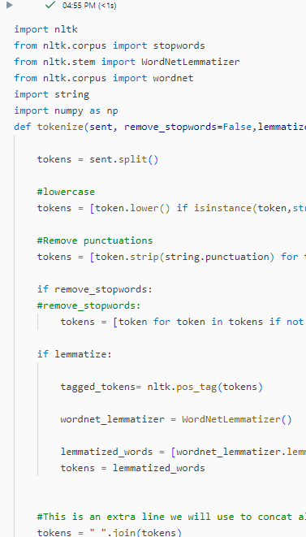
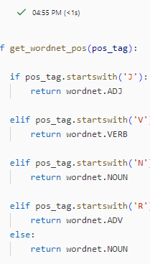
Data Preprocessing

Slide 13
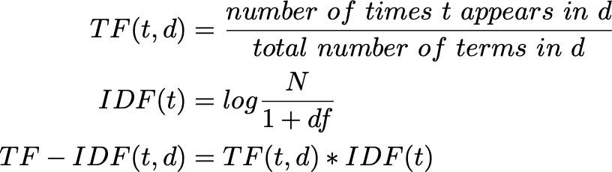
Data Preprocessing
TF-IDF: Term Frequency-Inverse Document Frequency: a statistical measure used to evaluate how important a word is to a document in a collection or corpus. This helps in weighing the relevance of terms within the dataset.

Slide 14
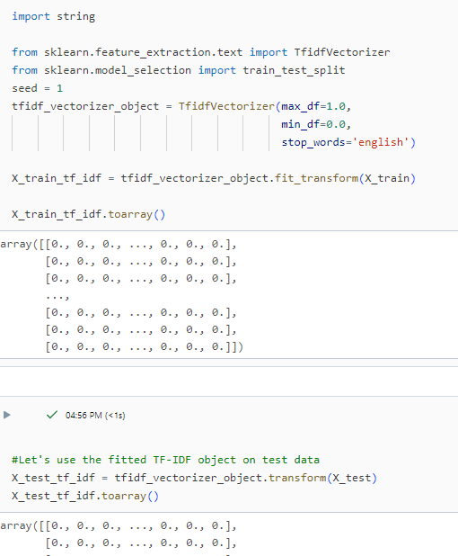
Word Embeddings
TF-IDF: Term Frequency-Inverse Document Frequency: a statistical measure used to evaluate how important a word is to a document in a collection or corpus. This helps in weighing the relevance of terms within the dataset.

Slide 15
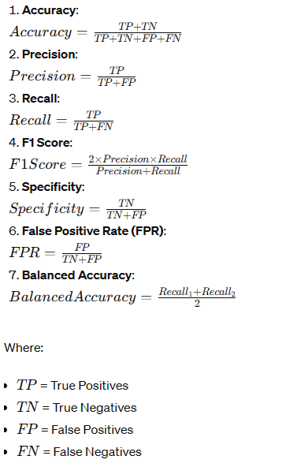
Data Model Building

Slide 16
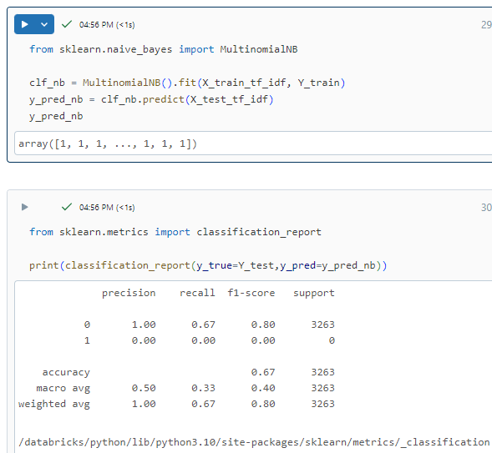
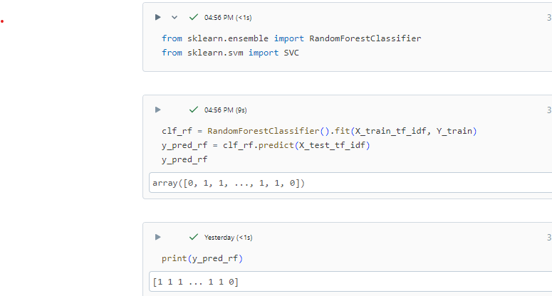
Data Model Building
Scikit-Learn Classifiers
Naïve Bayes
Random Forest
Gradient Boosting
Neural Networks

Slide 17
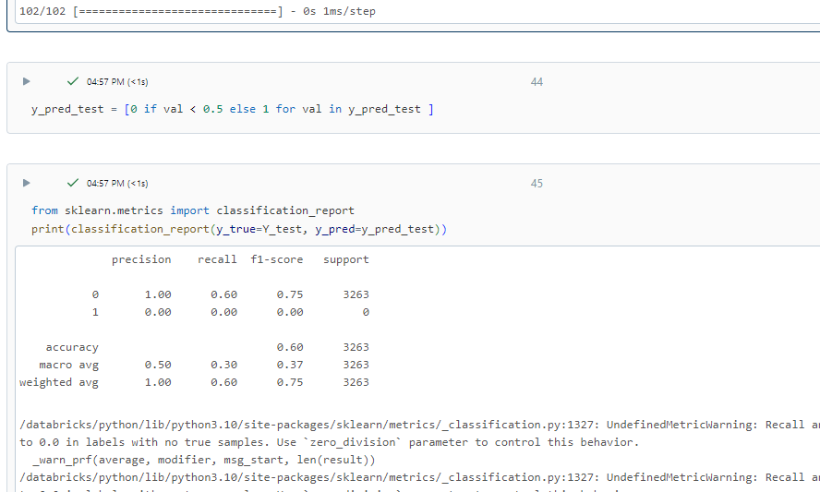
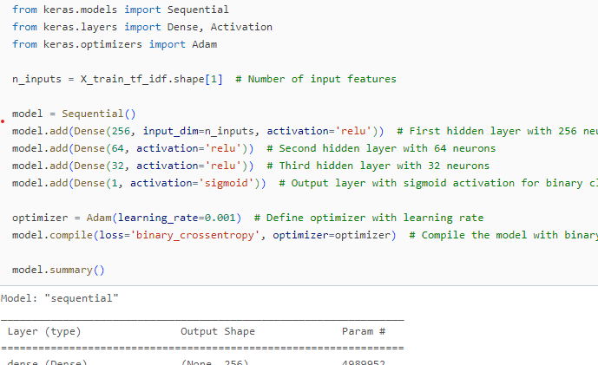
Neural Networks

Slide 18
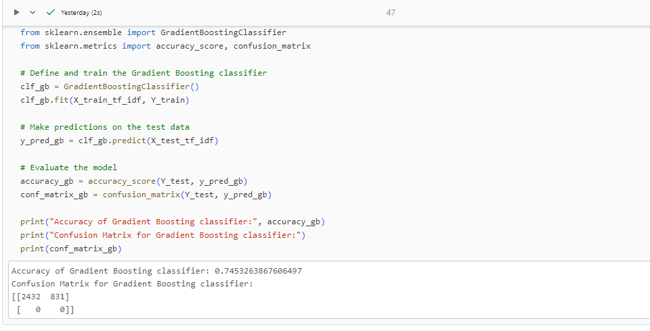
Gradient Boosting

Slide 19
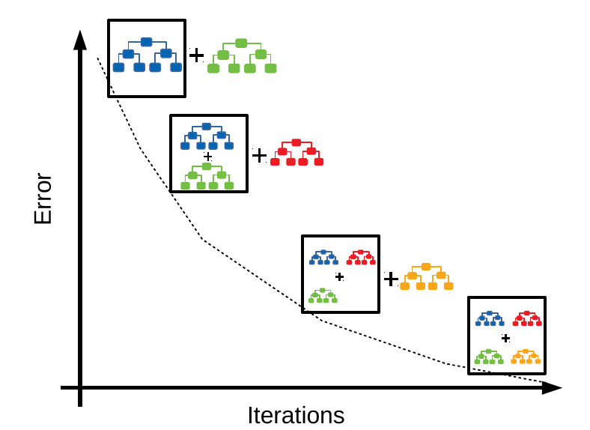
Data Model Building
Gradient Boost: An ensemble technique that
builds sequential trees, each correcting errors of
the previous one, effectively enhancing the model
performance for disaster tweet prediction.

Slide 20
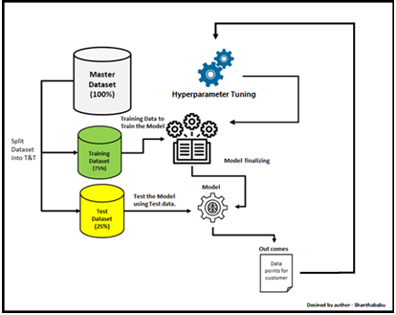
Model parameter
Learning Rate (η): Controls the contribution of each tree to the final model. Lower values make the model more robust to overfitting but require more trees.
Number of Trees (n_estimators): The number of boosting rounds or trees to build. More trees can improve accuracy but may increase the risk of overfitting.
Maximum Depth (max_depth): The maximum depth of each tree. Deeper trees can capture more complex patterns but may lead to overfitting.
Minimum Samples Split (min_samples_split): The minimum number of samples required to split an internal node. Higher values prevent the model from learning overly specific patterns.
Minimum Samples Leaf (min_samples_leaf): The minimum number of samples required to be at a leaf node. Larger values help in smoothing the model.
Subsample: The fraction of samples to be used for fitting each individual tree. Reducing this fraction can prevent overfitting but too small a value can lead to underfitting.
Maximum Features (max_features): The number of features to consider when looking for the best split. This can be a fixed number or a percentage of total features..

Slide 21
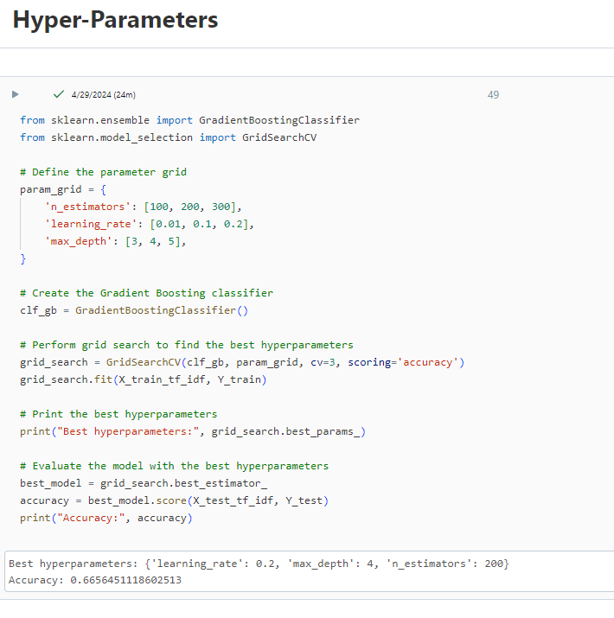
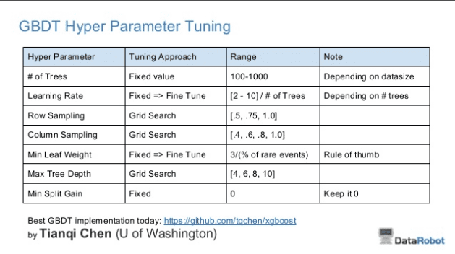
Model parameter

Slide 22

Hyper parameter
Hyperparameter tuning is the process of selecting the optimal values for a machine learning model’s hyperparameters. Hyperparameters are settings that control the learning process of the model, such as the learning rate, the number of neurons in a neural network, or the kernel size in a support vector machine. The goal of hyperparameter tuning is to find the values that lead to the best performance on a given task.

Slide 23
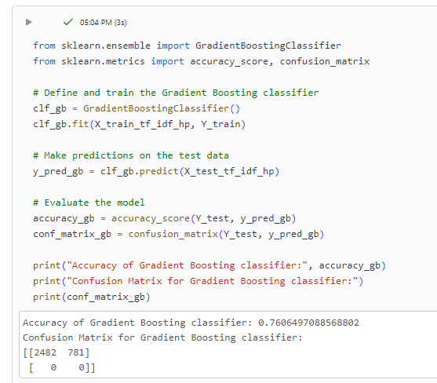
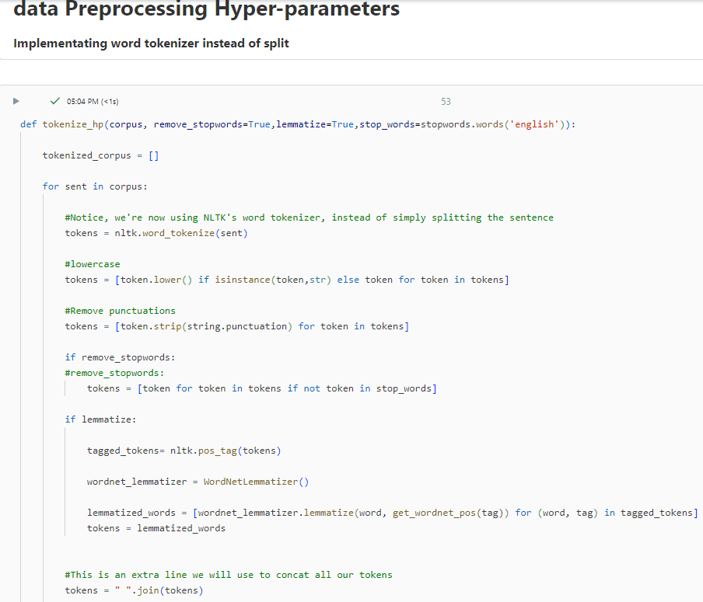
Hyper parameter

Slide 24
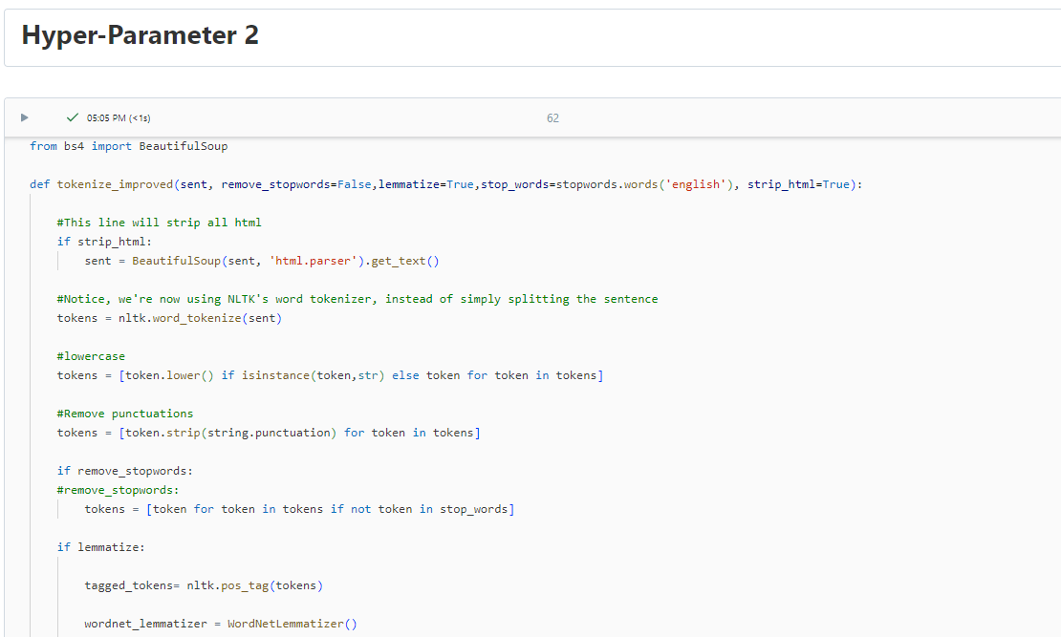
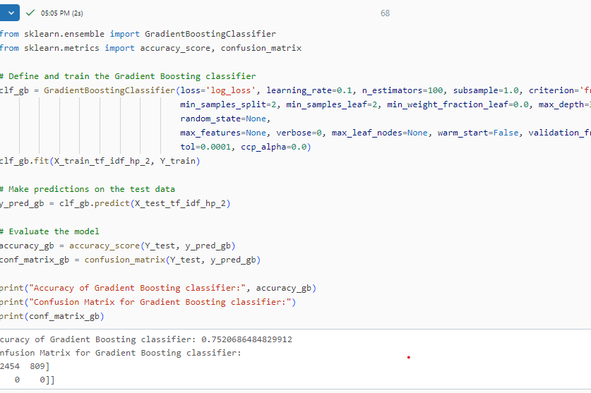

Hyper parameter – HTML Strip

Slide 25
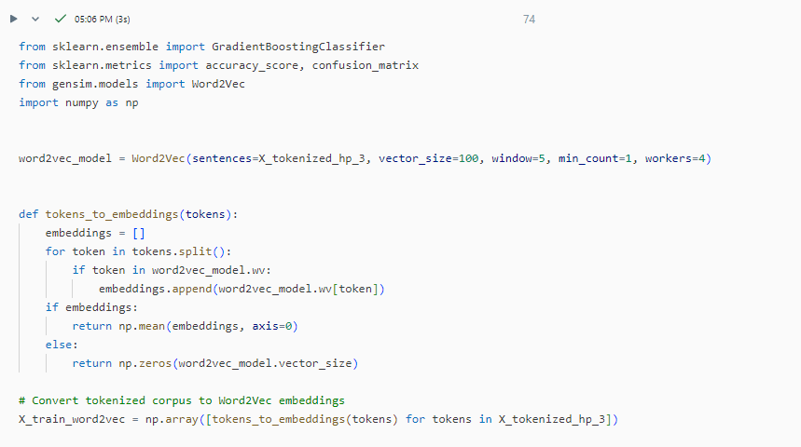
Hyper parameter – Word Embeddings

Slide 26
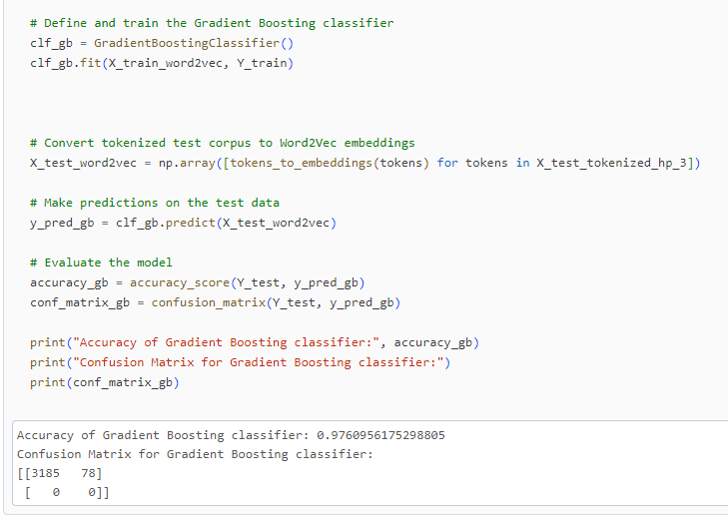
Hyper parameter

Slide 27
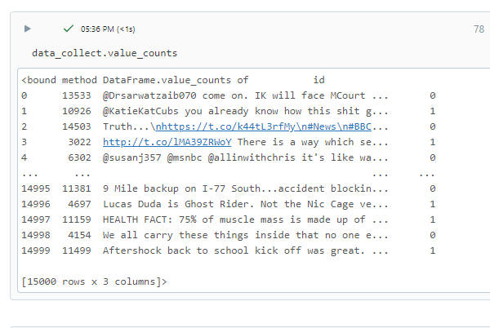
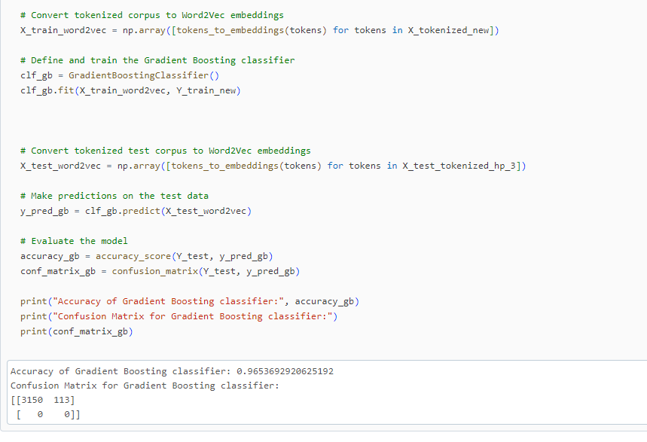
Hyper parameter Data Collection

